Slide 1
Solar power generation forecasting
Team members:
Srihari Madhavan
Priyanka Kankipati
Pavani Pratyusha
Pranay Chinnam
Moulika Narne
1

Slide 2
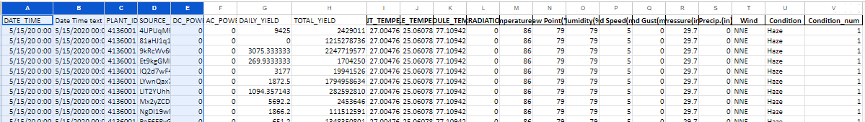
Data Extraction and Refinement
Merged Two different data sets (solar energy generation by plant and weather reports of that particular area) and interpolated the missing values.
Condition (categorical column) is converted into numerical (condition_num) using python (clustered similar conditions and assigned them numbers)
2

Slide 3
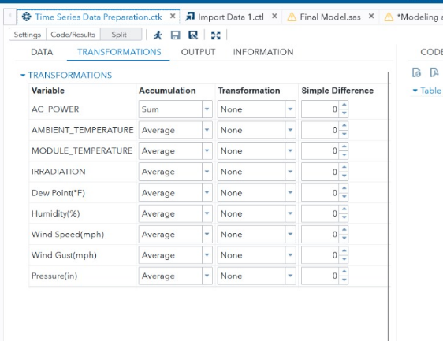
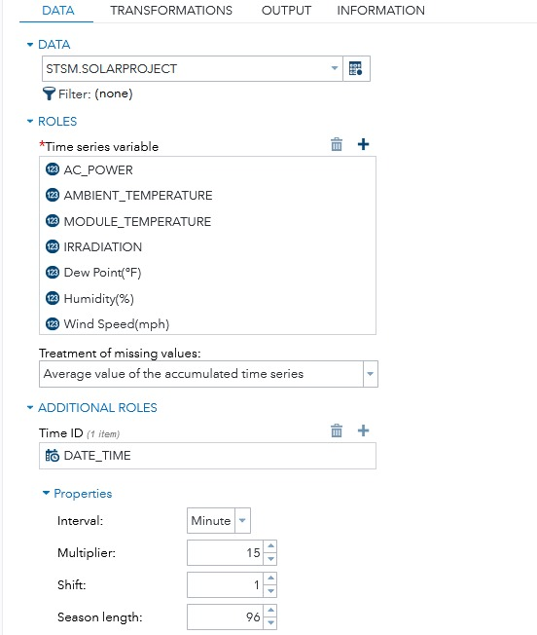
Time Series Data Set Preparation
Import data set to SAS.
AC_power as dependent
variable.
3

Slide 4
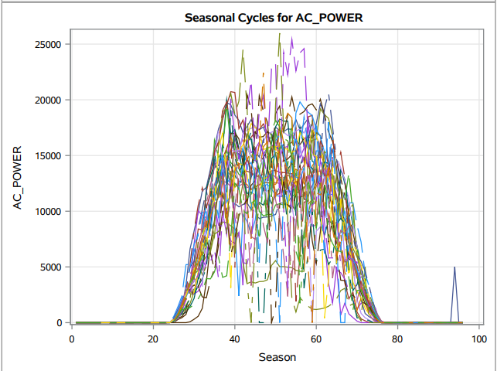
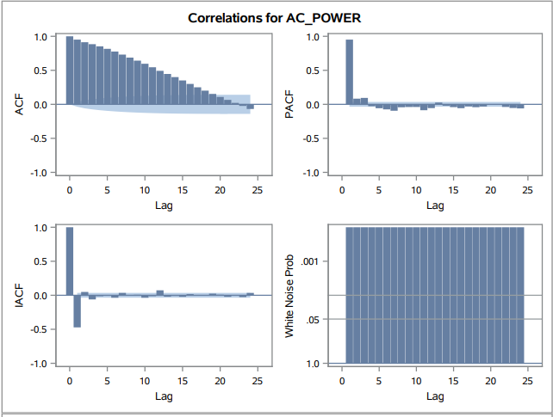
Time Series Exploration
Graphs show strong seasonality of AC_power.
Cross correlation : these variables needs be pre whitened
The time series (ac power) fails the unit root test, therefore its
stationary.
4

Slide 5
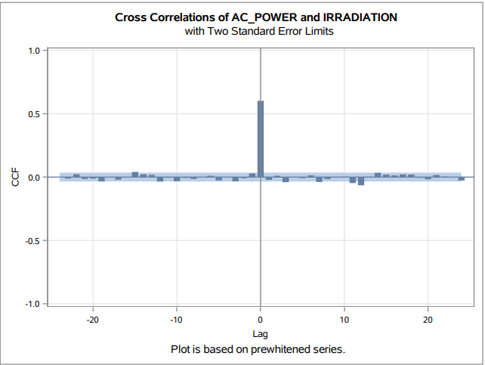
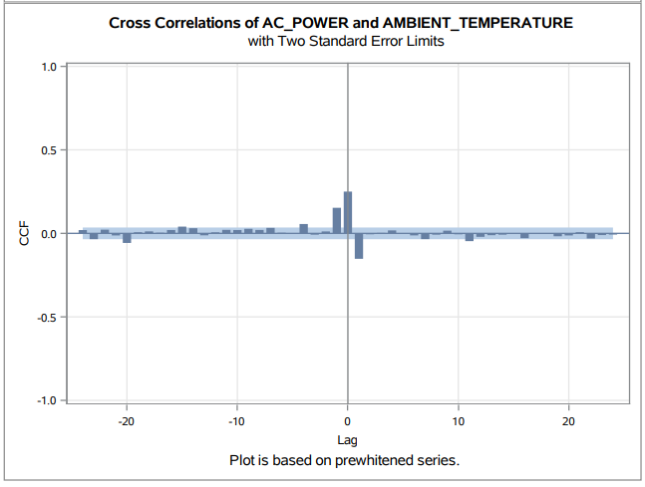
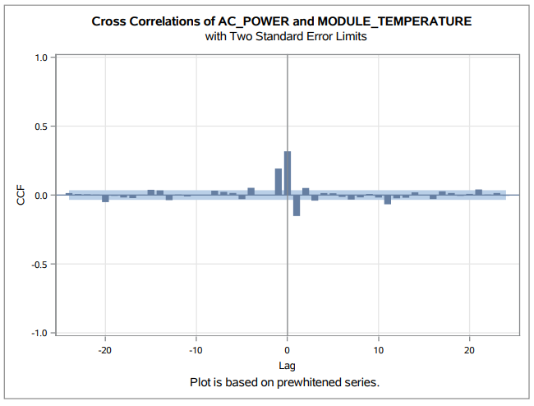
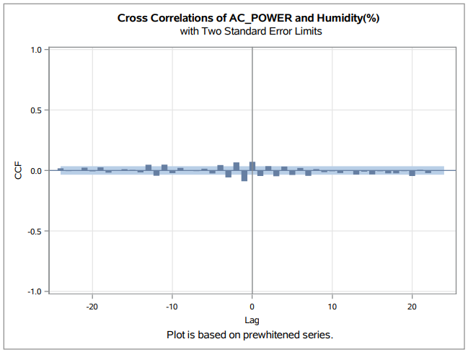
Pre whitening
5

Slide 6
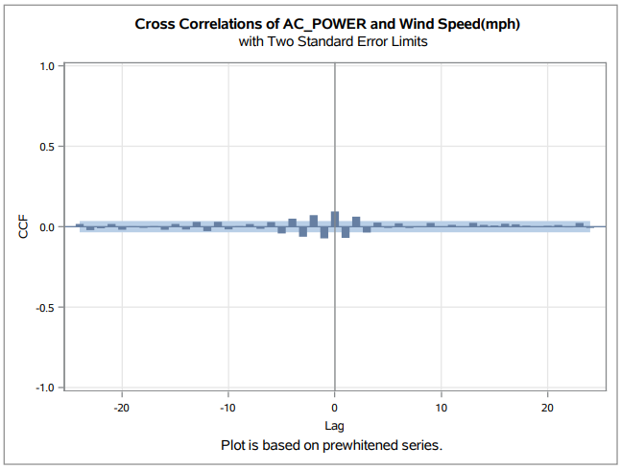
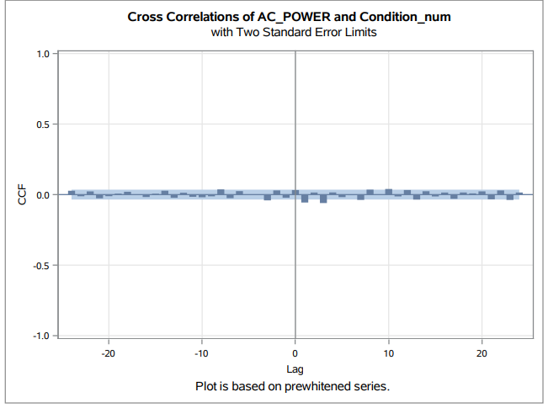
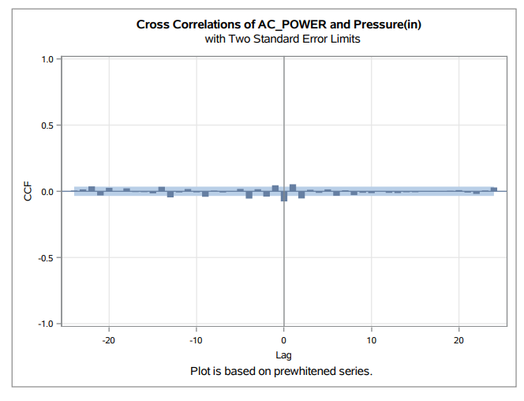
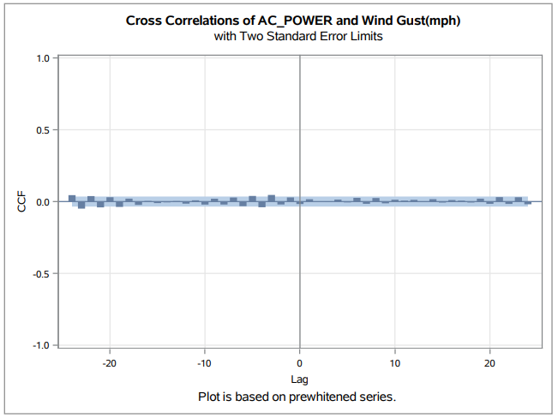
Pre whitening
6

Slide 7
Comparison of models
We notice a very slight difference in the error metrics within these models, but the best one being ARIMAX (p=9,d=0,q=3 ; P=0,D=1,Q=0).
We got best AIC and SBC at model ARIMAX (8,0,3 ;0,1,0).Since the MAPE values are only slightly different, we confirm that the best fit model is at ARIMAX (p=8,d=0,q=3 ; P=0,D=1,Q=0).
7

Slide 8
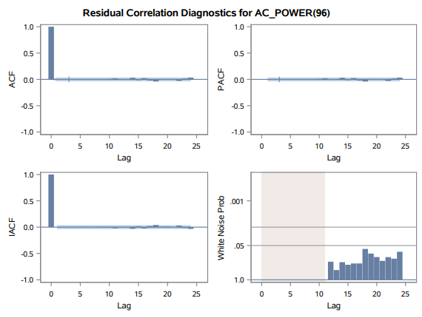
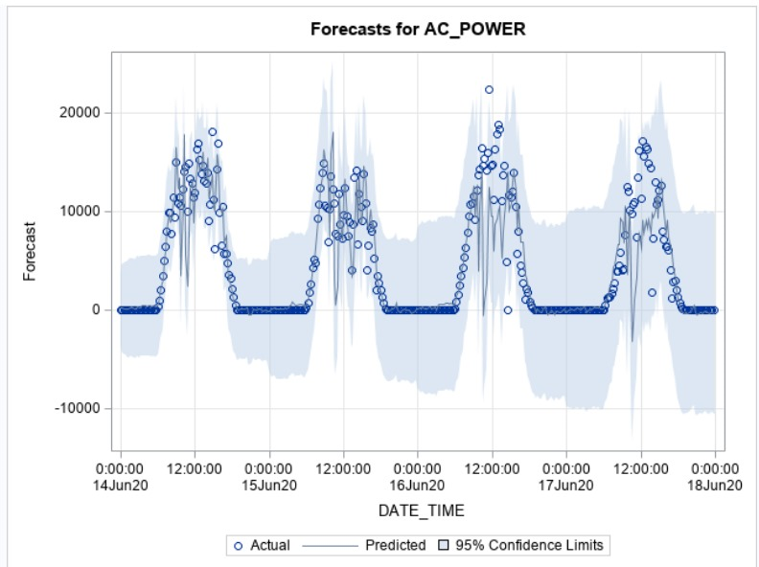
Best Model
We chose the independent variables as:
1)Ambient temperature,
2) Module temperature
3)IR-radiation
4) Humidity
5)Wind speed.
Passes the white noise test.
No significant peaks in ACF, PACF and IACF.
8

Slide 9
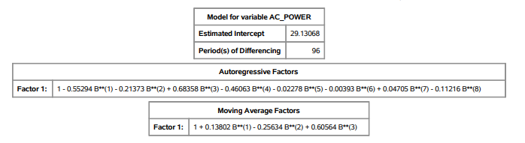
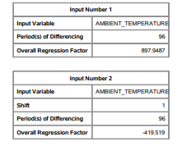
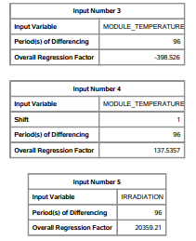
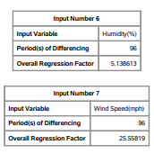
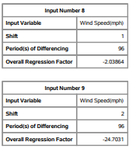
Best Model
9

Slide 10
Conclusion
Seasonality observed due to daily solar cycle.
ADF Test supports stationarity.
Dew point and pressure found to be insignificant in predicting AC_POWER.
IRRADIATION, AMBIENT_TEMPERATURE, and MODULE_TEMPERATURE are significant predictors
Wind Speed and Humidity, not significant, but still impact prediction due to panel cleaning and radiation transmission.
10

